Slide 1
Lesson 9 – Homework review

Slide 2
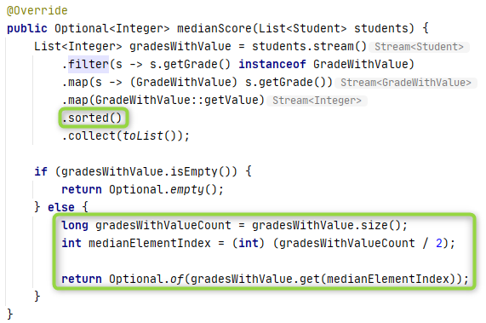
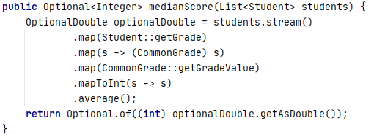
Median is not an Average

Slide 3
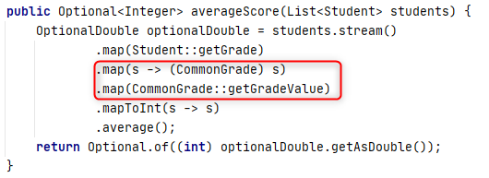
Incorrect average concept
avg[50, 50, 100]
-> avg(F, F, A)
-> avg(F, D, B)
-> avg(D, D, C)
-> D

Slide 4
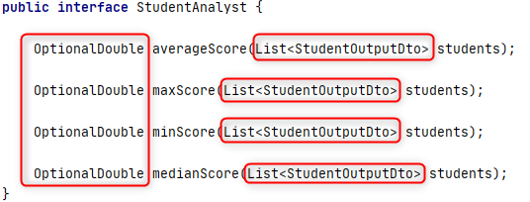
Changed contracts

Slide 5
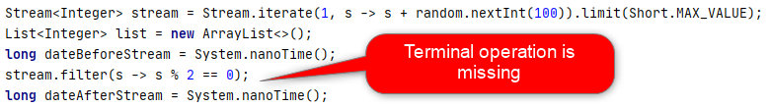
Stream laziness

Slide 6

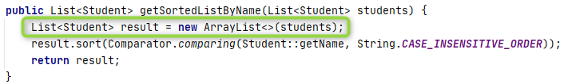
Input arguments modification is not good

Slide 7
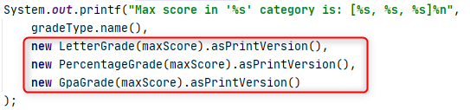
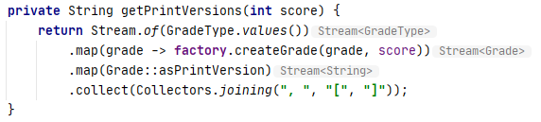
Open-Close simplifies maintainability

Slide 8
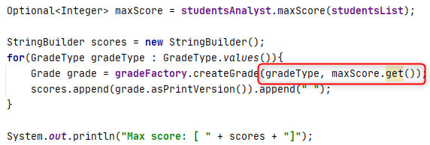
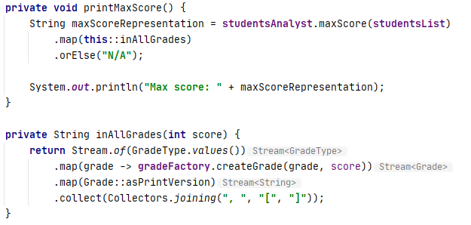
Empty input is a valid input

Slide 9
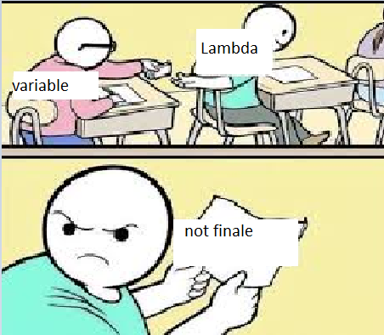
Fun

Slide 10
Thanks!
Any Questions?
Or find us in Slack:
@Yaroslav Brahinets
@Vasya Rudas

